Slide 1
EDI Mid Semester assessment SEM II 2022-23
Smart Catalytic Converter
Division : SY-IT-A | Group_ID : A7 | DATE : 20-05-23
Presented By:
Sarvesh Sunil Hadole(12111460)
Ojas Sunil Joshi(12111459)
Sneha Ramesh Kalaskar (12110531)
Kartik Banshi Katkar (12111367)
Project Guide:
Prof. Ranjeetsingh Suryawanshi
Department of Multidisciplinary Engineering
Vishwakarma Institute of Technology, Pune
A.Y.(2022-2023) SEM II
1

Slide 2
Contents
Introduction
Literature Review
Problem Statement
Objective of EDI Project
EDI Domain, technology and tools being used
Design- System Architecture
Methodology/Algorithm/Technique used
Executable Project Demo
Results and Discussions
Individual responsibility
Conclusion
References
2

Slide 3
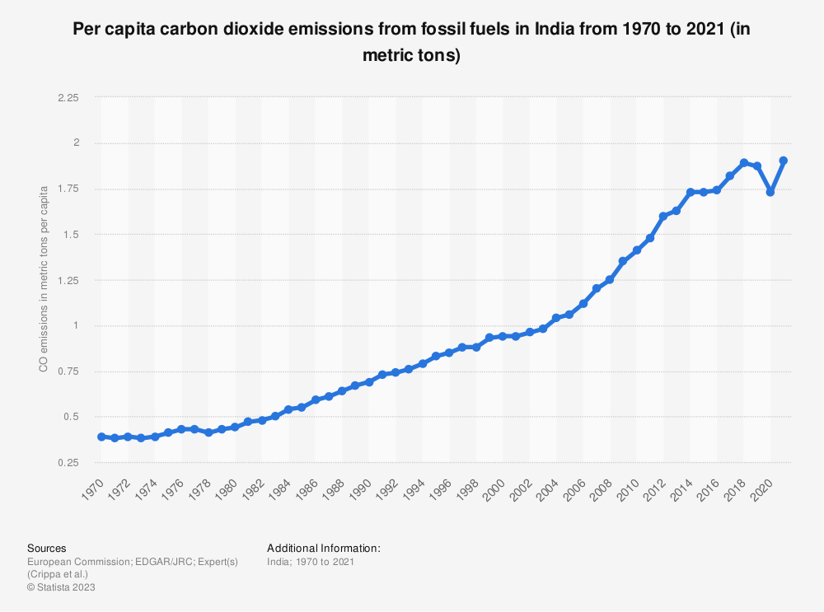
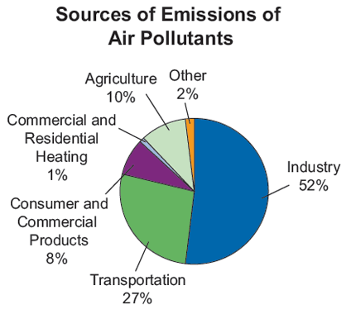
Introduction
Vehicular emissions are a significant contributor to air pollution in many developing countries.
This leads to adverse health effects and environmental degradation.
CO2 emissions [6]
Emission sources [9]
3

Slide 4
Literature Review
NAME | AUTHOR | PUBLICATION YEAR | METHODOLOGY | CONCLUSION | REMARK
Indoor Air Quality in the Uffizi Gallery of Florence: Sampling, Assessment and Improvement Strategies | Fabio Sciurpi Cristina Carletti Gianfranco Cellai Cristina Piselli | 29 August 2022 Applied Sciences MDPI Web of Science SCIE Indexing | This methodology examines exposed artefacts, ideal conservation settings, building characteristics air quality conditions, and building features. In order to evaluate the IAQ (Indoor Air Quality) conditions in the museum and the wellbeing of the staff and visitors, a survey was conducted in the Uffizi Gallery of Florence in 2019 with a focus on some representative rooms (nine) of the museum complex in terms of visitor turnout and HVAC systems, including rooms closed to the public. | To evaluate pertinent IAQ-related metrics, such as the concentration of chemical (CO2) and biological pollutants, some typical rooms inside the museum were chosen and short-term monitored. Systems for monitoring air quality can be used to measure the amount of pollutants. | In this article, Authors lay emphasis on the importance of Air Quality Monitoring Systems to preserve statues and historical monuments.
5

Slide 5
Literature Review Continued
NAME | AUTHOR | PUBLICATION YEAR | METHODOLOGY | CONCLUSION | REMARK
Impact of the 2021 La Palma volcanic eruption on air quality: Insights from a multidisciplinary approach | Penghua Wang Sailuo Wan Feihong Du Fengshou Qian Shuting Zhi | January 2023 Science of The Total Environment ELSEVIER SCOPUS INDEXED | The La Palma 2021 volcanic eruption in the Canary Islands (Spain) released 1.8 Tg of sulphur dioxide (SO2) into the troposphere over a period of almost three months (19 September–13 December 2021), which was more than the combined amount of SO2 produced by human activity in the 27 member states of the European Union in 2019. The effects of the 2021 volcanic eruption on air quality were thoroughly assessed by the writers. | The air quality in La Palma during the volcanic eruption was damaged by both natural phenomena simultaneously due to the rare feature of volcanic aerosols and desert dust impacting the lower troposphere in a same height range ( 0–6 km). Due to the combination of SO2 and volcanic ash, PM(Particulate Matter) surface concentration increased more as a result. | The findings of this study are important for emergency planning for future volcanic eruptions Understanding the mechanisms through which volcanic eruptions affect air quality is essential for mitigating and minimising effects on the population. Current Systems affected by corrosion
4

Slide 6
Literature Review Continued
NAME | AUTHOR | PUBLICATION YEAR | METHODOLOGY | CONCLUSION | REMARK
Design and Analysis of IoT based Air Quality Monitoring System | Ajitesh Kumar Mona Kumari Harsh Gupta | Feb 28-29, 2020 IEEE Xplore | mobile IoT based Air quality monitoring system which senses the real-time surrounding data with the help of three sensors MQ9 MQ2 PMS3003 G3 | Cost-efficient air quality monitoring system that senses the real-time data of surrounding various parameters like smoke, carbon monoxide, and PM level Alerts the people when the quantity of these elements goes beyond a certain limit and shows the data in an easily understandable format. | modify the system to notify a user about the air quality when it reaches beyond a permissible level through SMS or App.
6

Slide 7
Literature Review Continued
NAME | AUTHOR | PUBLICATION YEAR | METHODOLOGY | CONCLUSION | REMARK
Internet of Things (IOT) Based Weather Monitoring system | Mohmadfurkan A. Sabugar1 , Asst.Prof Ketan Patel2 | IARJSET Vol. 8, Issue 3, March 2021 | The proposed model consists of 4-tiers. The tier 1 is the environment . Sensor devices in tier 2 . Sensor data acquisition and decision making in tier 3 . Intelligent environment in tier 4. | The smart way to monitor environment and an efficient, low cost embedded system is presented with different models in this paper. | To protect the public health from pollution, this model provides an efficient and low cost solution for continuous monitoring of environment
Weather Monitoring system
7

Slide 8
Literature Review Continued
NAME | AUTHOR | PUBLICATION YEAR | METHODOLOGY | CONCLUSION | REMARK
Development of an IoT-based Real-Time Air Quality Monitoring Device | Bikash Kumar Moharana Prateek Anand Sarvesh Kumar Prakash Kodali | July 28 - 30, 2020 International Conference on Communication and Signal Processing From IEEE Xplore | They developed a device, which can measure air quality using MQ135 gas sensor which gives air quality in PPM. DHT11 sensor is used for measurement of temperature in degree Celsius and humidity in % RH. The air qualities in ppm, temperature & humidity values are logged in AWS server for the specific experiment period, which can be monitored using mobile app or laptop. | A major advantage of the designed system is its compact size. A single NodeMCU ESP32 has been incorporated in the system replacing the bulky duo of Arduino and Wi-Fi module for the purpose of uploading data to the internet platform. | The system is well suited for continuous monitoring of air quality in any area over longer durations of time.
8

Slide 9
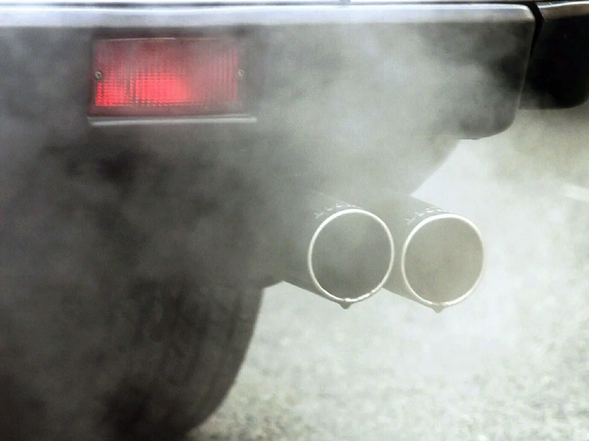
Problem Statement
Current systems for monitoring and reducing vehicular emissions face several limitations.
Traditional catalytic converters in vehicles are passive devices.
As a result, they may not always perform optimally, leading to inefficient emission reduction and increased air pollution.
Car exhaust [7]
9

Slide 10
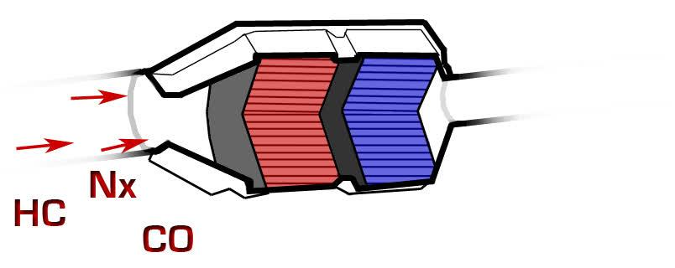
Problem Statement
The smart Air Quality Monitoring System can address the limitations of the current systems
It provides an innovative solution for monitoring and reducing vehicular emissions.
Integration of this system with vehicle systems may help reduce pollution.
Catalytic converter [8]
10

Slide 11
Objectives
To provide a low-cost and effective solution for monitoring air quality of the air emitted from vehicles.
To enable visualisation of pollutants' levels over a period of time.
11

Slide 12
Domain
"IOT in Environment Monitoring"
Environment pollution is one of the core problems which is hampering the natural inhabitants. The changes in climate led to the increased importance of environmental monitoring. In order to determine the quality of the environment, continuous tracking of the environmental parameter is needed
With air quality monitoring, science and industry can create change. These critical metrics deliver the insights for municipalities to make decisions for urban planning, for industrial operations to mitigate their impact, and for entire auto makers to continually improve designs to reduce emissions.
12

Slide 13
Tools Technology Used
NodeMCU ESP8266
16*2 LCD Display
Jumper Wires
Blynk
MQ135 Sensor
DHT11 Sensor
I2C Converter
3.7 V Power Supply
13

Slide 14
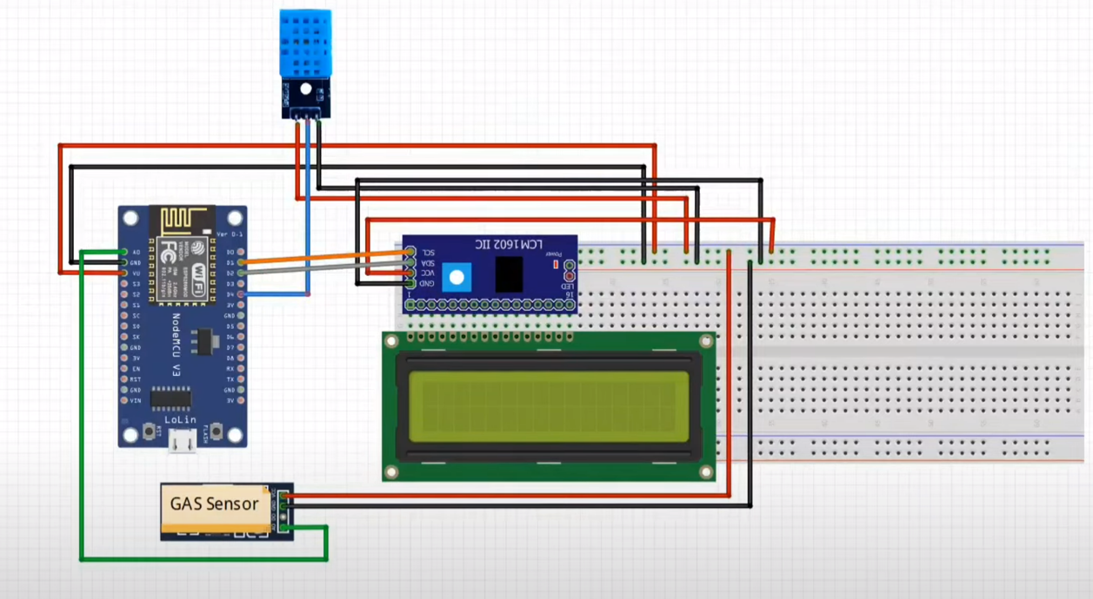
Design: System Architecture
DHT 11
I2C Converter
ESP8266
LCD Display
MQ135
14

Slide 15
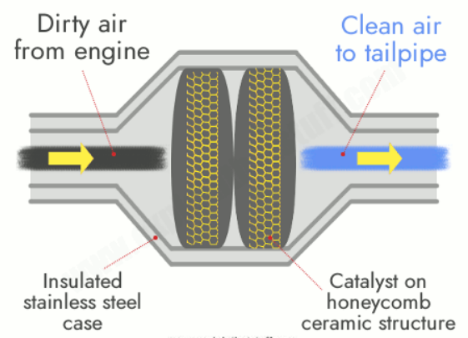
Design: Real Life Application
15

Slide 16
Design: Important Points
Sensor Placement
DHT11 placement
MQ135 Placement
Communication:
Communication Protocol
Data Transfer
Enclosure and Protection:
Physical Enclosure
Environmental Protection
Thermal Management
Scalability:
Modular Design
Expansion Ports
16

Slide 17

Methodology
Initialize the system
Set up the LCD display
Main Loop
sendSensor Function
17

Slide 18

Methodology
Display Temperature On LCD
Display Humidity on LCD
Check and Display gas values
Pollution Alert
18

Slide 19
Executable Project Demo
19

Slide 20
Results and Discussions
The implementation of a smart catalytic converter integrated with an air quality monitoring system yields several significant results and discussions.
Real-time Air Quality Monitoring
Enhanced Pollution Reduction Efficiency
Environmental and Public Health Benefits
Future Research and Development - Continuous advancements in air quality monitoring technology will enhance the accuracy and reliability of pollution data.
20

Slide 21
Individual Responsibility
Although the work was divided equally and all the members worked on both hardware and software aspects of the project. Here is a brief description of individual responsibility.
Sarvesh - Adapting the Blynk platform to meet the needs of our project
Ojas - Interfacing software and the sensors for the project design theory
Sneha - Acquiring components and connection of hardware
Kartik - Research and selection of the components with the specifications required for the project
21

Slide 22
Conclusion
In conclusion, Air pollution is a significant global concern impacting public health and the environment.
The development of a smart catalytic converter integrated with an air quality monitoring system is crucial. Continuous monitoring and dynamic performance adjustment maximize pollutant reduction efficiency.
The integration of air quality monitoring and intelligent control is a significant advancement in emission control technology.
Implementation of smart catalytic converters can contribute to a healthier future for all.
22

Slide 23
REFERENCES
[1] A. Kumar, M. Kumari and H. Gupta, "Design and Analysis of IoT based Air Quality Monitoring System," 2020 International Conference on Power Electronics & IoT Applications in Renewable Energy and its Control (PARC), Mathura, India, 2020, pp. 242-245, doi: 10.1109/PARC49193.2020.236600.
[2] B. K. Moharana, P. Anand, S. Kumar and P. Kodali, "Development of an IoT-based Real-Time Air Quality Monitoring Device," 2020 International Conference on Communication and Signal Processing (ICCSP), Chennai, India, 2020, pp. 191-194, doi: 10.1109/ICCSP48568.2020.9182330.
[3] Mohmadfurkan A. Sabugar1 , Asst.Prof Ketan Patel2," Internet of Things (IOT) Based Weather Monitoring system "International Advanced Research Journal in Science, Engineering and Technology Vol. 8, Issue 3, March 2021 DOI: 10.17148/IARJSET.2021.830 .
[4] Milford, Celia, et al. "Impact of the 2021 La Palma volcanic eruption on air quality: Insights from a multidisciplinary approach." Science of The Total Environment 869 (2023): 161652.
[5] Sciurpi, F.; Carletti, C.; Cellai, G.; Piselli, C. Indoor Air Quality in the Uffizi Gallery of Florence: Sampling, Assessment and Improvement Strategies. Appl. Sci. 2022, 12, 8642.
23

Slide 24
REFERENCES
[6] CO2 emissions from cars Indian Institute of Tropical Meteorology
[7] https://www.theguardian.com/commentisfree/2016/feb/04/car-fumes-air-pollution-ban-motorists
[8] https://anbuvelavan.blogspot.com/2012/11/catalytic-converter.html
[9] https://maria79-blog.tumblr.com/post/4394889301/pie-chart-showing-what-the-factors-are-for-the
24

Slide 25
Thank You

